Slide 1


LRU Cache
BY YASVI VAGHASIYA
Branch : CE
Division : D6
Roll No. : 166
Enrollment No. : 22002170110199

Slide 2
LRU Cache
By Zeni Chakalasiya
Branch : CE
Division : D2
Roll No. : 47
Enrollment No. : 22002170110016

Slide 3
TABLE OF CONTENT
INTRODUCTION
FUNCTIONALITIES
FLOWCHART
IMPLEMENTATION OF LPU
MERITS & DEMERITS
USES OF LRU

Slide 4
INTRODUCTION
The fact is the world is doomed with computer , people’s daily living and how the world works nowadays become more modernized. Yet, this is the
external reality in this computer era.
There are more instances that troubles occur which we are supposed to solve in order to regular or stabilize operation.
In order to that , there’s what we call mapping functions which we used to avoid conflict of data processed which involve different replacement algorithms.
One is Least Recently Used(LRU).
It used to replace a block that has been in the cache longest with no references to it.
This will be useful to lessen the errors and cache miss.

Slide 5
Functionality Of LRU :
There are Two Functionality which I used :
1. HashMap
2. Deque
Algorithm :
Create a class LRU Cache with declare a list of type K. an unordered map of type
<K , V> and variable so store maximum size of the cache.
1.Put() → If the element not present in the list then add to the last of the list. when the
cache is full then new item needed to be inserted and the least recently used item must be evicted.
2.Get() → If the element is present and found successfully in cache’s hash-map then item is considered as recently used , so it is moved to the front of deque and the value associated with the key is returned as the result of get operation.

Slide 6
Functionality Of LRU :
There are Two Functionality which I used :
1. HashMap
In my class I have use a hashmap to store the address of node for quick retrieval of cache entries. Here’s functionality is: private Node [] cache = new Node [1000];
2. Deque
I also use a doubly-linked list(Deque) to maintain the order of recently used items.
I declare head and tail nodes to maintain a DLL. The head represents the most recently used node, and the tail represents the least recently used node.
Algorithm :
1.Put() → If the element not present in the Deque then add to the last of the Deque. When the cache is full then new item needed to be inserted and the least recently used item must be evicted.
2.Get() → If the element is present and found successfully in cache’s hashmap then item is considered as recently used, so it is moved to the front of Deque and the value associated with the key is returned as the result of get operation.

Slide 7
FLOWCHART
MAIN METHOD
ENTER NUMBER FOR FIBONACCI SERIES
BY FIBONACCI ALGORITHM
BY FIBONACCI ALGORITHM BUT WITH LEAST RECENT USED LOGIC
CALCULATED BY NORMAL METHOD
CALCULATED BY LRU CACHE SYSTEM
TIME WILL BE SHOWN FOR THESE METHOD
TIME WILL BE SHOWN FOR THESE METHOD
DISPLAY THE SERIES

Slide 8
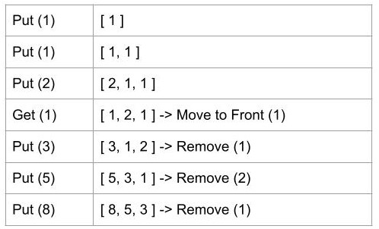
Implementation of LRU
F(N) = F(N-2) + F(N-1)
1
-
0
1
1
2
3
5
0
1
2
3
4
5
6
-
-
F(0)
F(1)
F(2)
F(3)
F(4)
-
F(0)
F(1)
F(2)
F(3)
F(4)
F(5)

Slide 9
Merits and Demerits :
Merits
Fast Access and update : It takes O(1) time to access the data from the LRU cache.
Fast Update: It takes O(1) time to update a key-value pair in the LRU cache.
Fast removal of Least recently used data: It takes O(1) delete that which has not been recently used.
Demerits
It requires large cache size to increase efficiency.
It requires additional Data Structure to be implemented.
Hardware assistance is high.
In LRU error detection is difficult as compared to other algorithms.
It has limited acceptability.

Slide 10
Uses of LRU:
Web Browsers
Operating System Page Replacement
Database Management System
Network Router and Switches
Search Engines
Game Development
Compiler Optimization
WO1hW!

Slide 11
Thank
you

